Slide 1
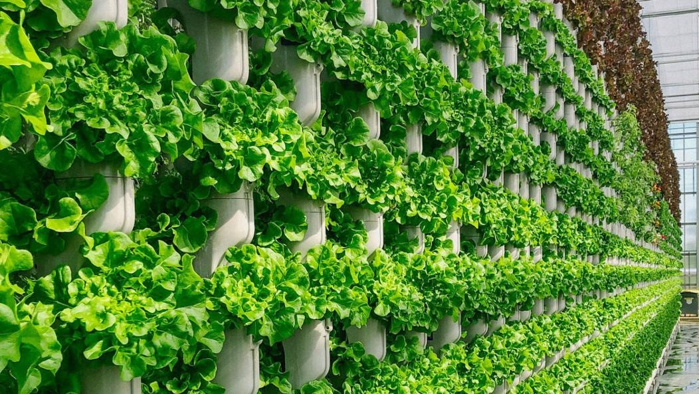

CERES SYSTEMS DATA SOLUTION FOR REVOLUTIONIZING THE GROWING WORLD

Slide 2
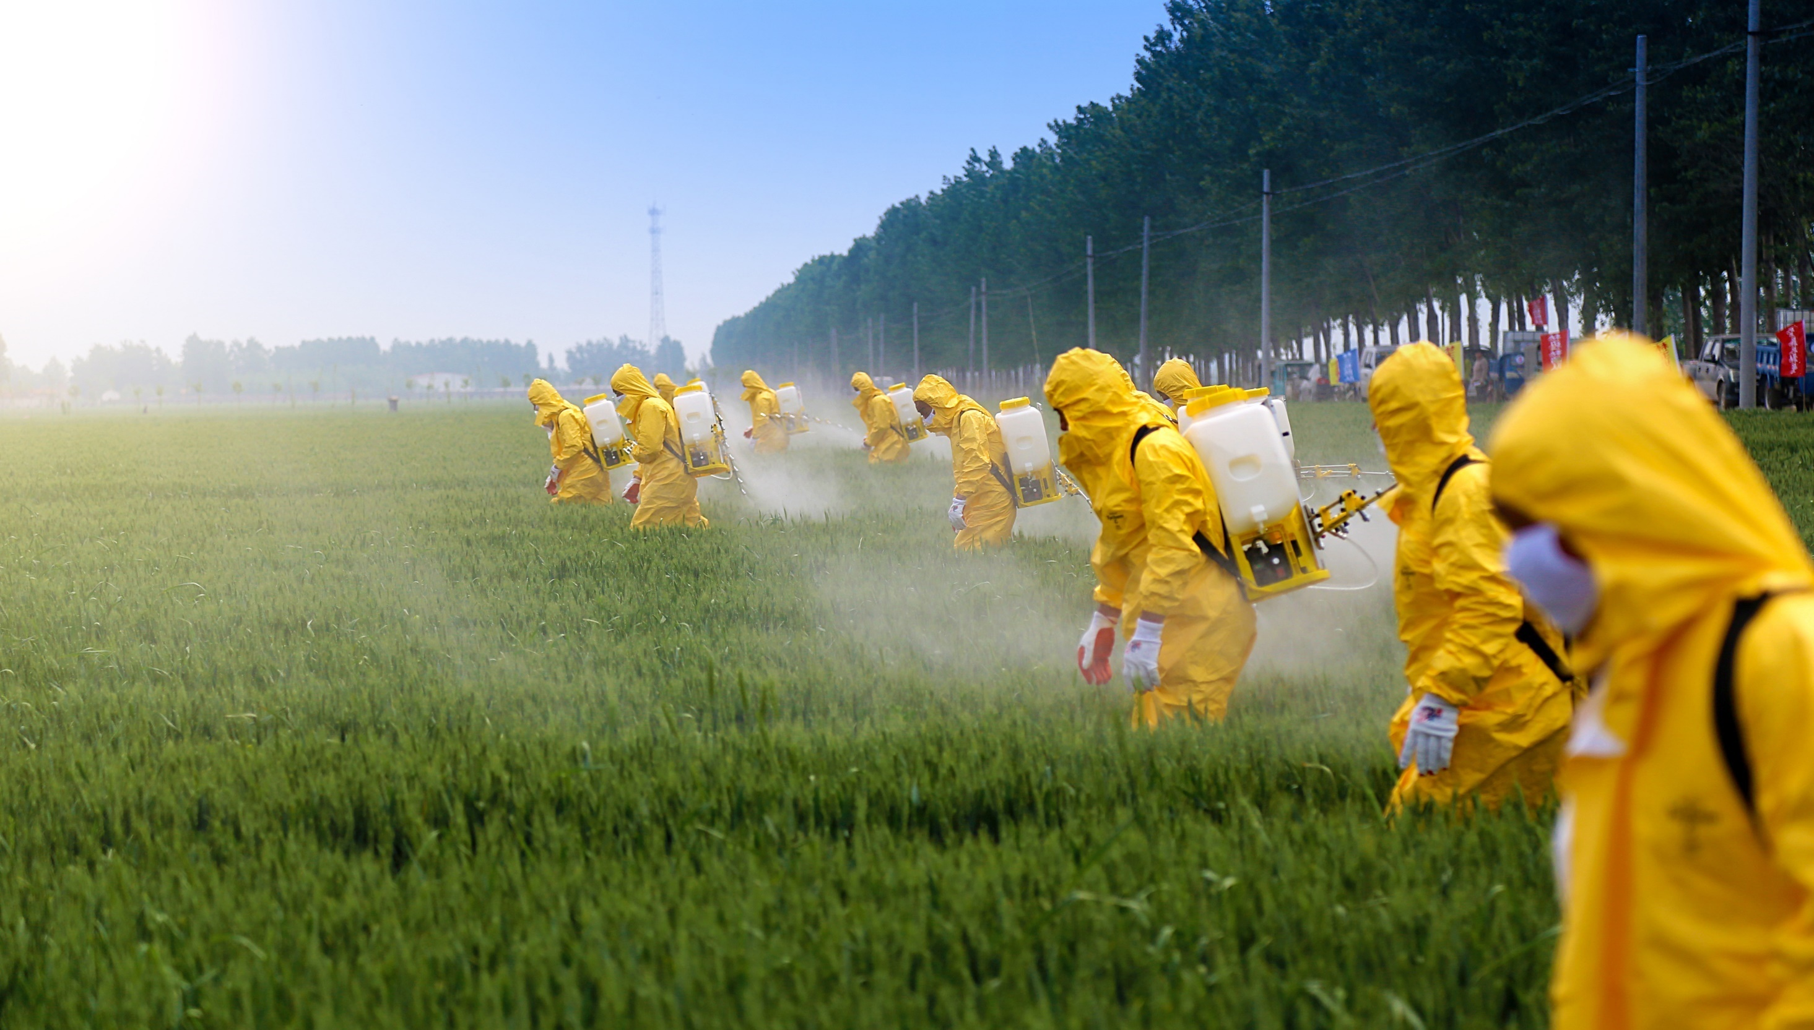
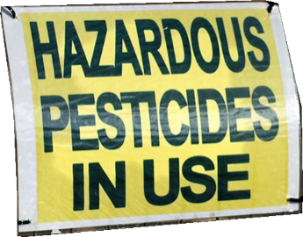
OUR FOOD SUPPLY IS BROKEN
Demand for organic food is growing so fast that consumer demand is outstripping domestic supplies 8:1
The US Spent 13.7b in 2017 to import organic food
Organic food typically travels 1500 miles from farm to plate. During transit it is require by law to spray the trucks with harmful pesticides

Slide 3
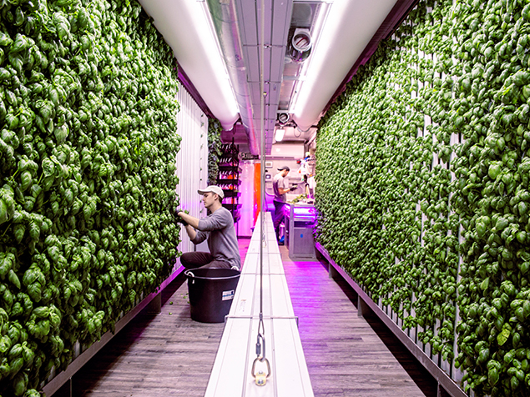
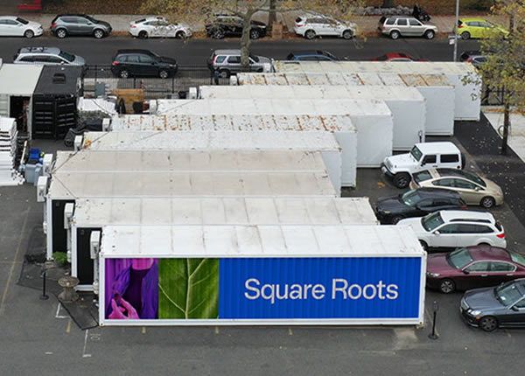
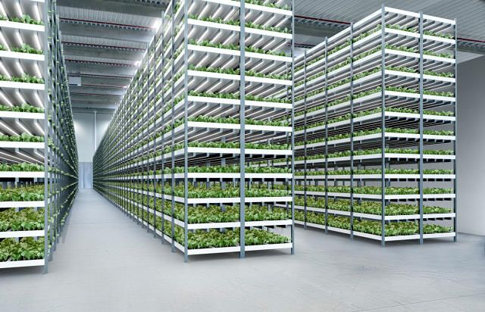
VERTICAL FARMING TECHNOLOGY
Vertical farming is the practice of growing crops in vertically stacked layers. It often incorporates controlled-environment agriculture, which aims to optimize plant growth, and soilless farming techniques such as hydroponics, aquaponics, and aeroponics
Increased crop yield
Smaller footprint
Grow anywhere
No pesticides
2

Slide 4




CURRENT VERTICAL FARMS IN THE US
Located in New Jersey, Aerofarms has raised $230M in funding
Located in San Fran, Plenty raised $200M in a Series B in 2017
Located in New York, Bowery raised $20M in a Series A in 2017 and took in another $90M at the end of 2018 in a Series B round
With farms in Pennsylvania, Ohio, Illinois and Virginia, Bright Farms has been rapidly expanding with over $100M raised.

Slide 5
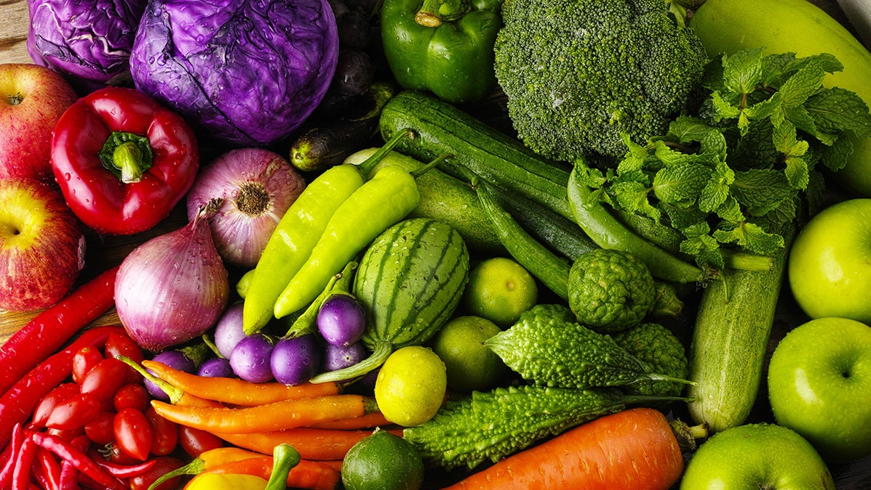
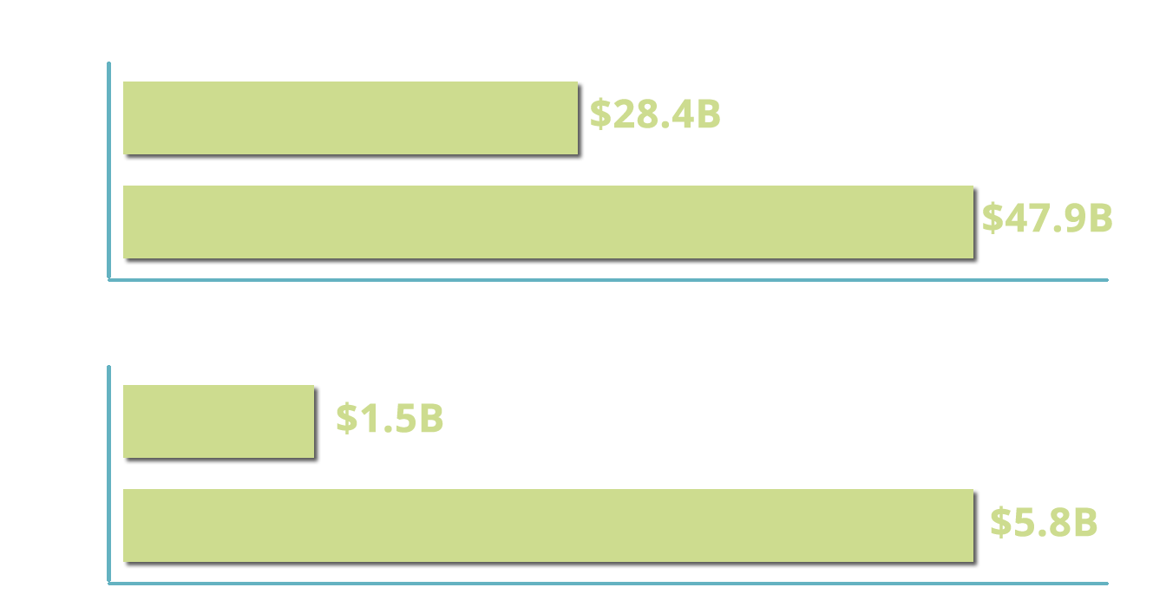
INDUSTRY OUTLOOK
* According to the USDA
8
* According to the marketsandmarketsresearch.com

Slide 6
THE PROBLEM
The vertical farming movement is rapidly growing in the US with no way of marketing and selling their products beyond local farmers markets
Difficult for farmers to anticipate market trends
The cost of organic, non-gmo food is prohibitive
Food waste from traditional farming
6

Slide 7

OUR BIG IDEA
To revolutionize the agricultural world with a data centric analytical technology platform to empower farms with data and create an integrated network for B2B and B2C distribution channels
We discover patterns in data, from suppliers and consumers to develop effective marketing strategies, increase sales, decrease costs and fine tune how to produce maximum crop yields
5

Slide 8
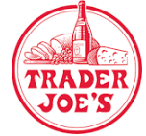
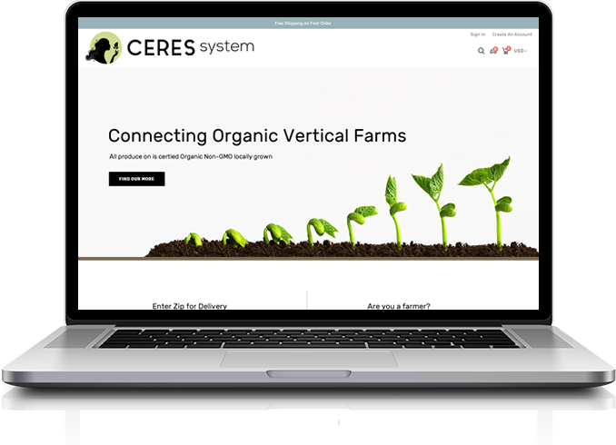









THE SOLUTION
Bridging the gap between local organic farmers and consumer
7

Slide 9
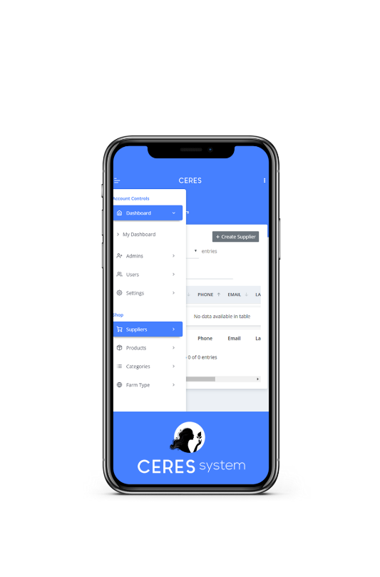

THE SOLUTION
DATA EXCHANGE
Capturing farm data to increase crop yield, enhance existing infrastructure and give real time market trends and insights
7

Slide 10


OUR SERVICES
Vertical farming data
Ability to supply new and existing enclosed vertical farms with growing data to speed up production time.
Supplier services
End to end setup with the ability to manage and publish available items, payment processing for orders and fulfillment.
Consumer services
Search by zip code for organic, non-gmo items available from selectable farm types. Purchase items for pickup or delivery through ecommerce shopping cart experience.
Platform to be used by external company data scientist/developers to capitalize on farming crop business yields.
Predict demand, provide trend insights, and optimize pricing.
IOT services to suppliers (farmers) to perform Ag-tech
KPI Dashboards for suppliers to track stats
9

Slide 11
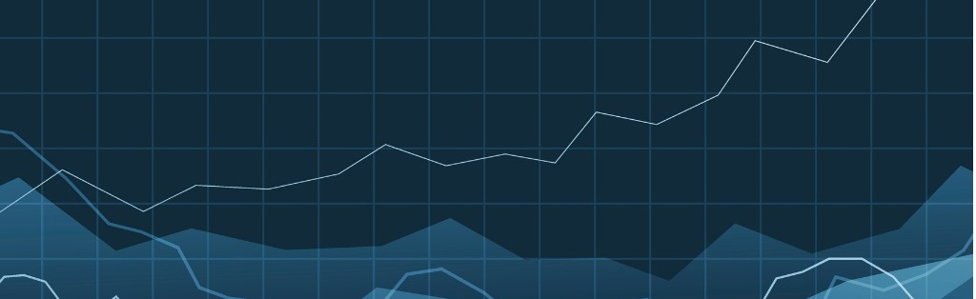
REVENUE MODEL
Transaction Fees
Advertising / 3rd Party
Consumer: Free
Business Consumer: .1%- 3%
Supplier: .1%-3%
Per click ad space: $1-$10
3rd party reseller: 10%-20%
Software Licensing
$20,000 - $10,000,000
10

Slide 12

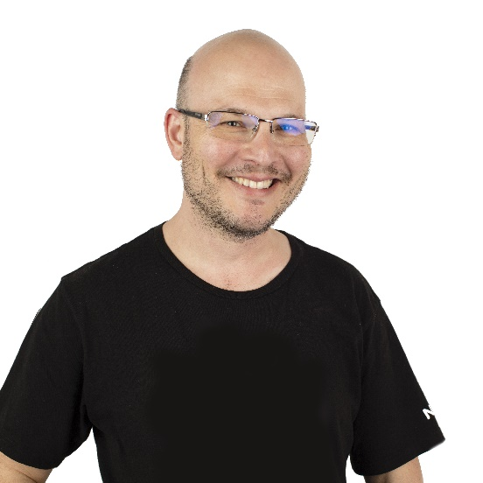



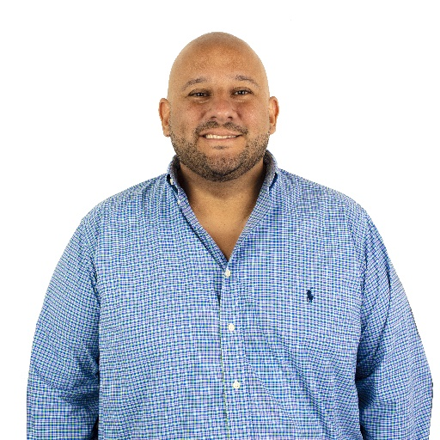
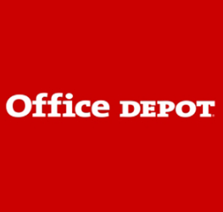







THE TEAM
Alex Lokshin
CTO
Alex Gibson
UI Architect
Technology Director Office Depot
Garrett Funkhouser
CEO
Anu Pabla
Solutions Architect
Lawrence Muchnick
Sales and Marketing Lead
Founded Good Clean Vapes in 2013
Franchised the business
Sold in 2018 for 3x multiplier
11

Slide 13
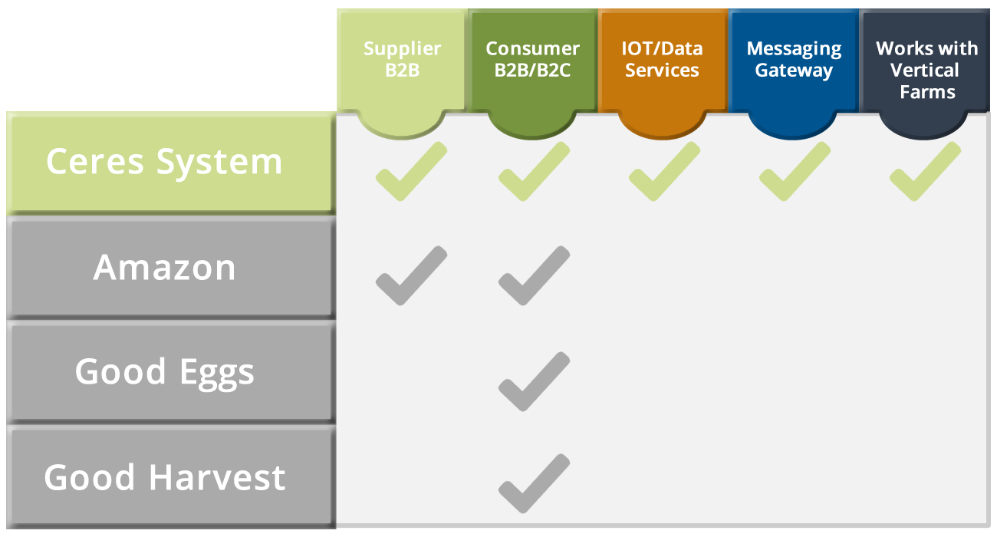
MAJOR COMPETITORS
Supplier B2B
Consumer B2B/B2C
IOT/Data Services
Messaging Gateway
Works with VF Farms
Amazon
Good Eggs
Good Harvest
Ceres System

Slide 14

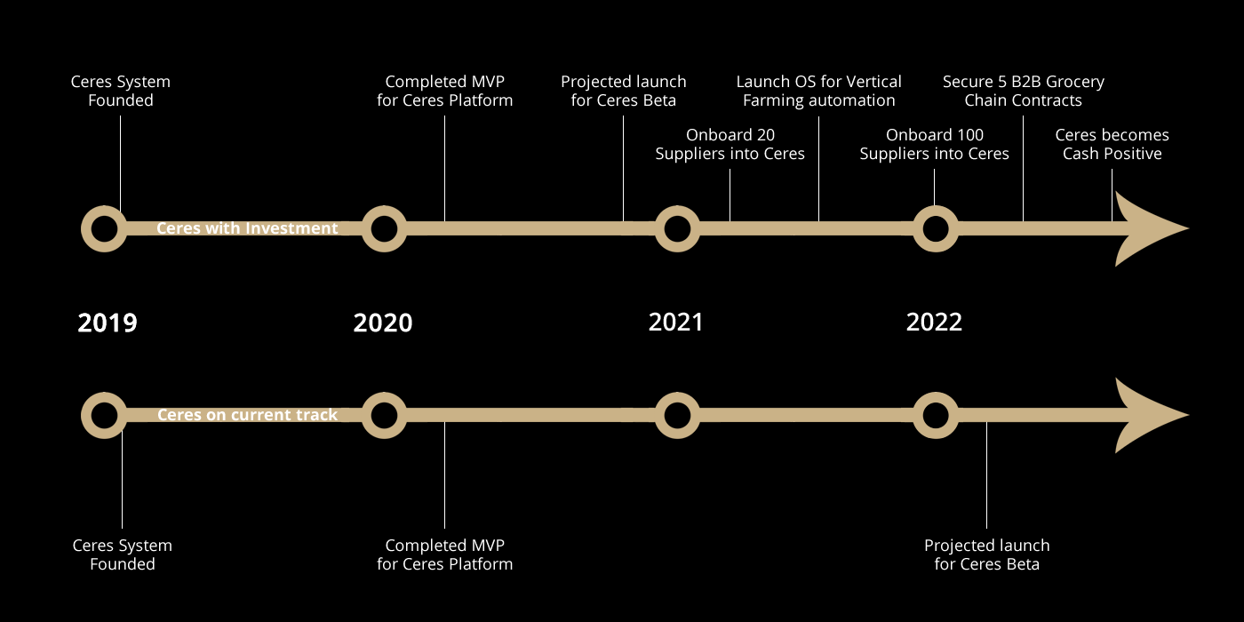
OPPORTUNITY
INVESTMENT
$10 Million
We are 2 years out of Beta with out current pace and commitments
With funding and full time commitment to Ceres we with reach Beta in 6 months

Slide 15
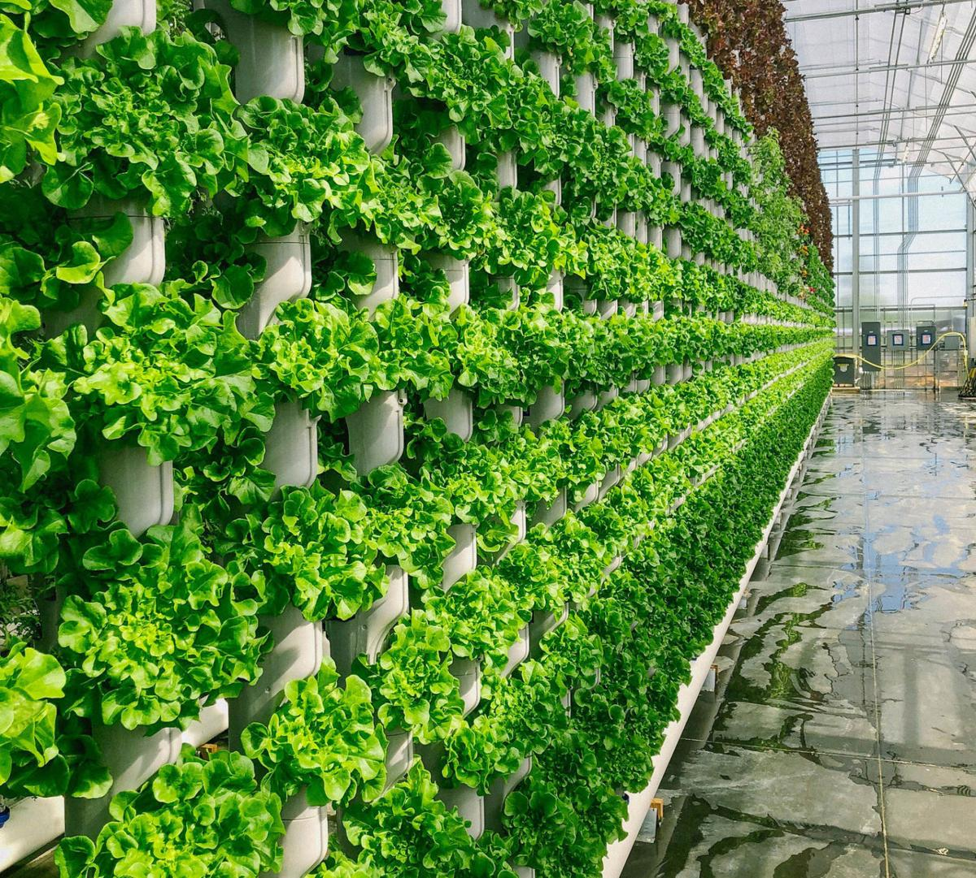



GIVE IT A GROW!
Garrett Funkhouser
admin@ceressystem.com
561 350-1575

