Slide 1
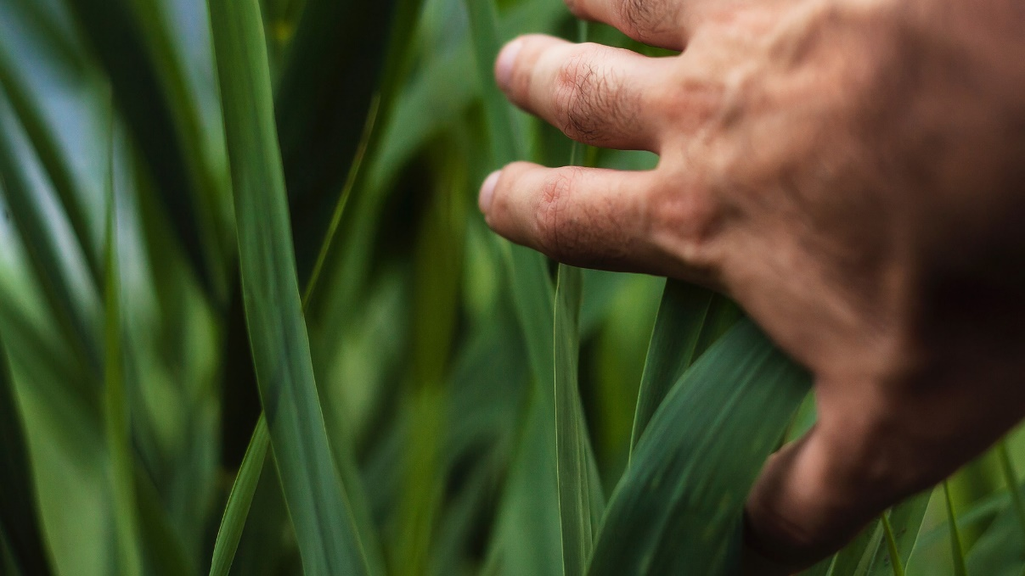

Digital Platform System

Slide 2

System Overview
Digital exchange platform for carbon credits that will allow users to track production and consumption of carbon credits
Automated tracking system for trees throughout the lifecycle to accurately calculate carbon intake
KPI dashboards for consumers and producers to view carbon credit production in real time

Slide 3


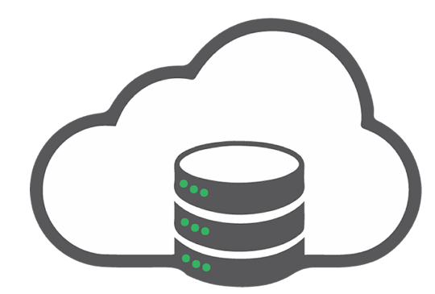


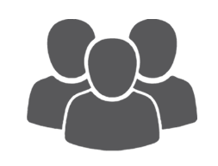

RainTree Digital Platform
Satellite Imagery
Landowners
Consumers
Cloud
RainTree Admin
BioCenters

Slide 4
RainTree Digital Platform Use Cases
Tree Inventory Supply Management
Update
Delete Inventory
Calculate Carbon Credits
Tree Inventory Shipment
BioCenters
Trace Tree Groups
Lifecycle with unique identifier
Manage User Profiles & Orders
Tree Inventory Order
Consumer Reforestation Reports
Manage Reforestation Projects
Publish Manage Reforestation Projects
RainTree Admin
Reforestation Project Coordinator
Login
Logout
Monitor reforestation projects (ESRI)

Slide 5


The RainTree Carbon Credit
BioCenters
GPS Scan
Satellite
RainTree Digital Platform
Each sapling group is barcoded at the BioCenter with species and age
When sapling groups are planted they are scanned and tagged with GPS location
Satellite data capture through ESRI
RainTree’s system collects all the data and utilizes machine learning (AI) to calculate each saplings carbon intake

Slide 6
Development

Slide 7
Phase 1 - Analysis
30-60 Days
Deeper analysis of carbon calculations
Blockchain whitepaper
BioCeter data
Business analysis (requirements)
Infrastructure analysis

Slide 8
Phase 2 - POC
3-6 Months
Setting up sprints based on business requirements
Data Accessibility/Integrity
System will track inventory produced at each BioCenter
System will calculate carbon credit production in real time
ESRI integration
System Profile Administration Panel
User Accounts
User accounts are password protected. System will need to support authorization/authentication for all types of users

Slide 9
Phase 3 – Beta
3-6 Months
Blockchain evaluation (ROI on exchange fees - gas) ETH/Allgorand/proprietary
QA testing
Beta launch

Slide 10
BioCenters
SOP for deployment (build recommendations)
Caching system (downtime possibility)
Switching (24/48 ports)
NFC for tree groups (exploratory)
Near field mobile antennas with local storage for on going data collection (IOT)

Slide 11
DevOps
User Support
Ticketing system (Jira)
System be to be ID track internal and external users
Integrates with Confluence
DevOps management modules
Zen Desk
Omni channel
Automation
Integrates with G-suite

Slide 12
Infrastructure
Cloud (AWS)
Firewalls
Production Environment
Checkpoint systems
Two vCPU systems
scalable
Dev/QA Environments
Checkpoint system CloudGaurd
Two vCPU systems
scalable
Remote access
Netscope or Merkai site to site

Slide 13
Competitive Analysis

Slide 14

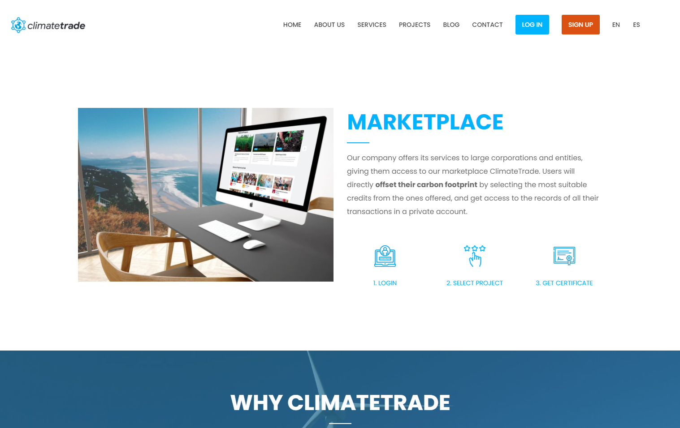
Create an account and get a certificate. No ability to trade credits
Originally ClimateCoin - note that climatecoin.io redirects to climatetrade.com - which has been around since 2017
They claim to use blockchain to verify carbon credits, and while blockchain can be used for verification, the info of how they are using blockchain to verify carbon is actually being offset is not clear
Difficult to verify state of legitimacy of this company; little to no information -- however it appears they are as recently as December 2020 not ready
Based in Spain

Slide 15

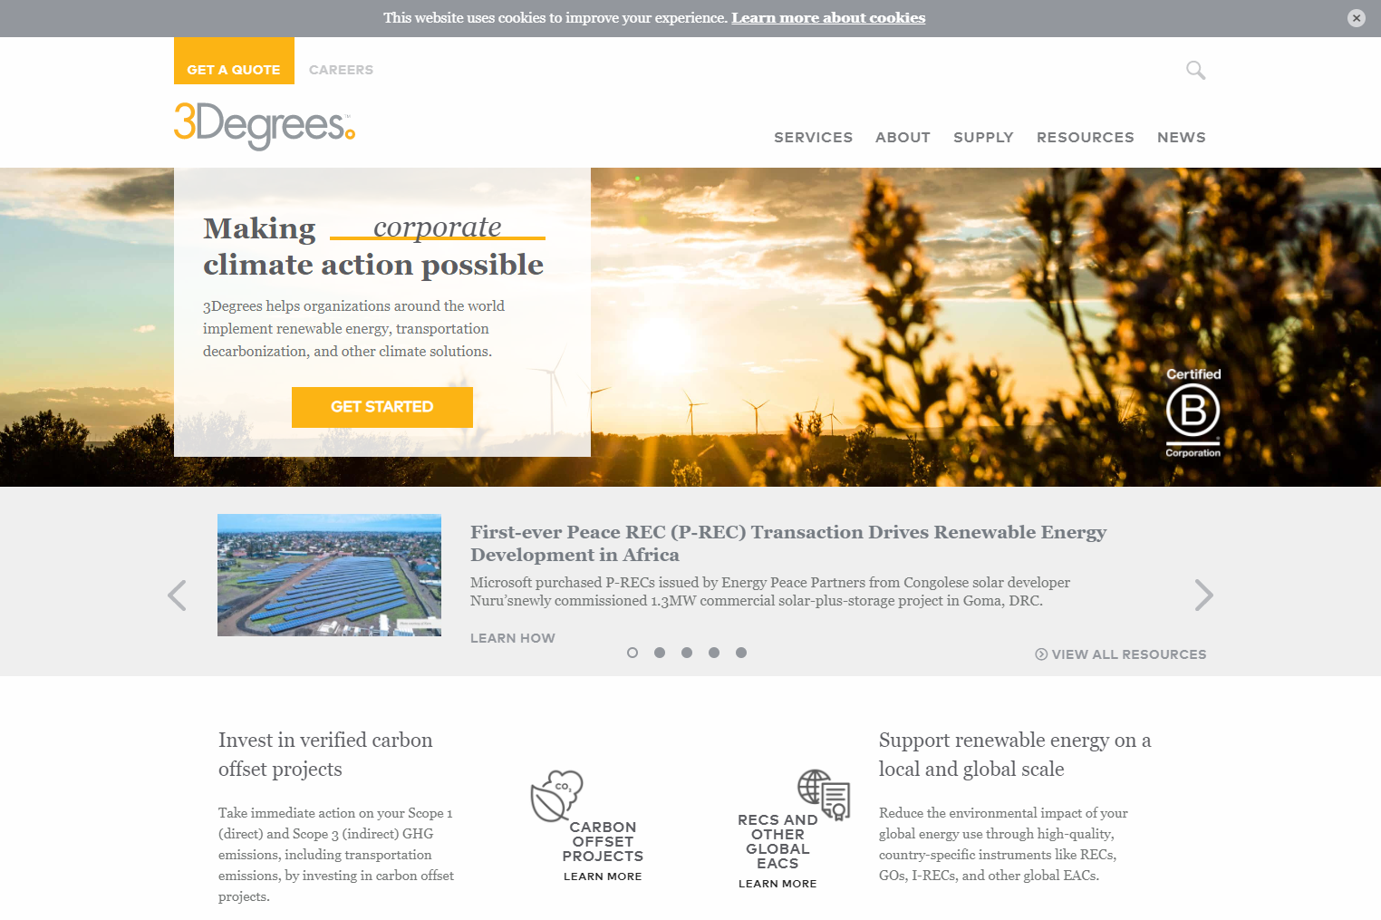
Supporting a portal for folks wanting to sell supply. Not trading platform
Have a lot of renewable energy offsets, but also have a big hold in North America on carbon offsets, some with forest management, but are not limited to forestry
Facilitate both the sale and purchase of credits - it is difficult to ascertain what “platform” type tools they offer, since both their sell and purchase involve long forms for a quote and to gather information
Looking at their Etsy case study, it appears they are more of a “broker” in the traditional sense of connecting buyers with sellers on a very client-specific, manual basis

Slide 16

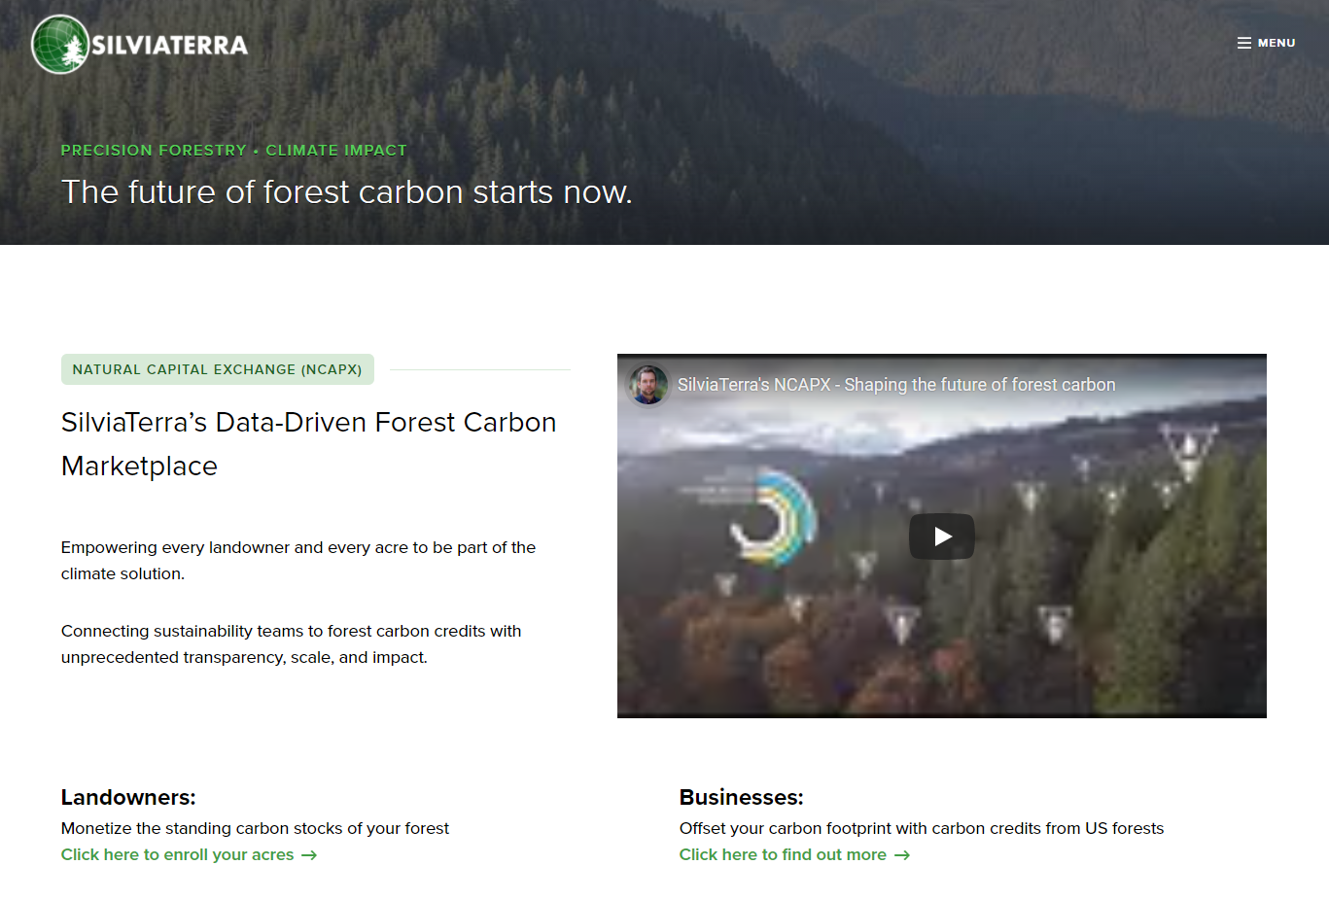
Manual process for carbon credits – not digital
SilviaTerra uses GIS to baseline tract of forest for “normal” harvesting in order to verify that *less* harvesting is done at the end of an annual contract in order to verify a carbon offset (less deforestation vs planting new trees)
They have developed a survey of the entire continental united states all forest acres, this development was done in partnership with Microsoft
NCAPX is their platform their sales process is not automated, but also they need to vet at minimum the land owners as being legit, and they have announced 200,000 metric tons of offset carbon credit purchased by Microsoft:
1 year contracts for landowners
This company is 100% legit and since they are offering landowners to offer land, doing data analysis based verification, and selling to companies such as Microsoft, this appears to be a carbon credit trading platform
The landowner gets paid at the end of 1 year, after verification of their offset

Slide 17


No platform exists. portal based solution
Pilot program focused on soil
Requires application to join
$3000 - $5000 project verification costs by a 3rd party
Provides a NORI crypto currency token for reselling - basically it is an ERC721 NFT which is issued to the farmer; the farmer can sell the NRT token later (I guess to a new farmer joining in the future? Unclear why these tokens would be worth buying later since the carbon has already been retired) Still an interesting concept
Nori carbon credit lasts 10 years e.g. the carbon is removed for a period of 10 years
Looking to hire software engineers

Slide 18

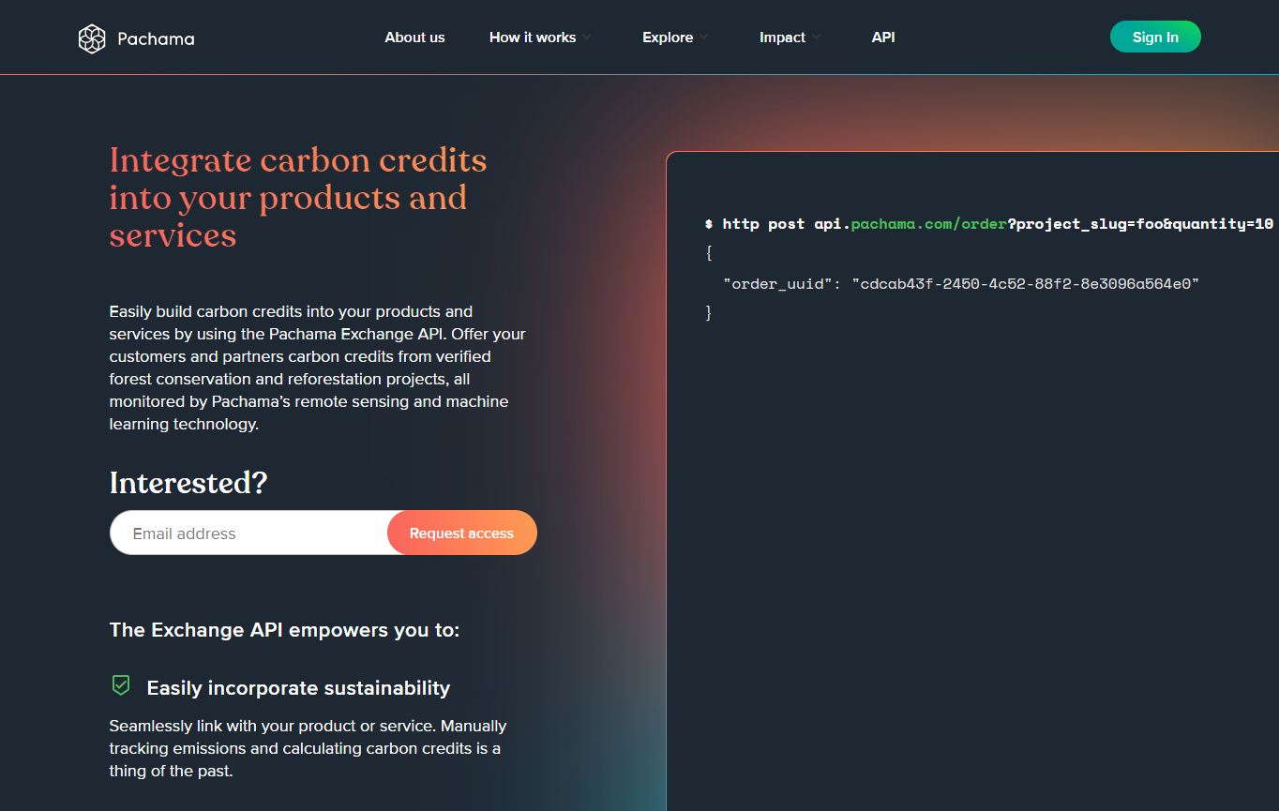
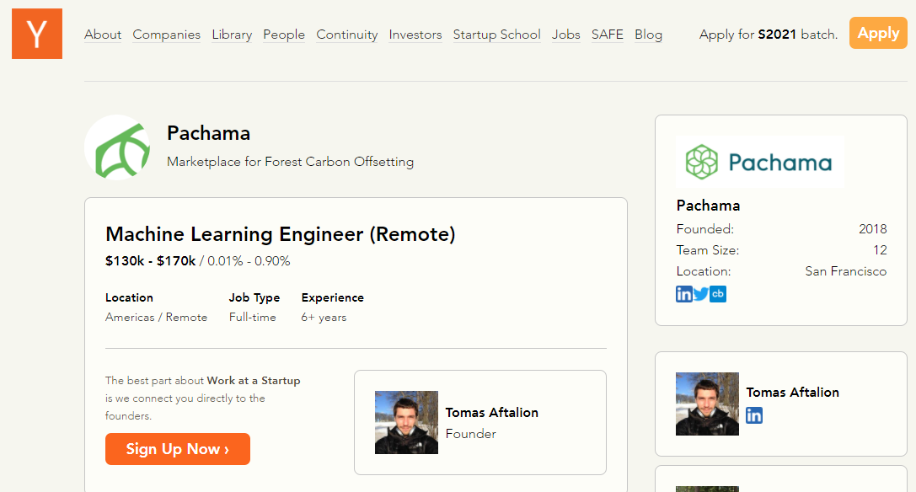
Heavy on machine learning based verification
$4m seed funding
A competitor
Similar to SilviaTerra with use of technology
Their API allows you to offer / sell carbon credits but it is not a “platform” or “marketplace” in the sense that they source the projects that are already verified by standards orgs which they then allow carbon credit buyers to support
Recurring theme of extreme vetting of the “sellers” of carbon credits

Slide 19

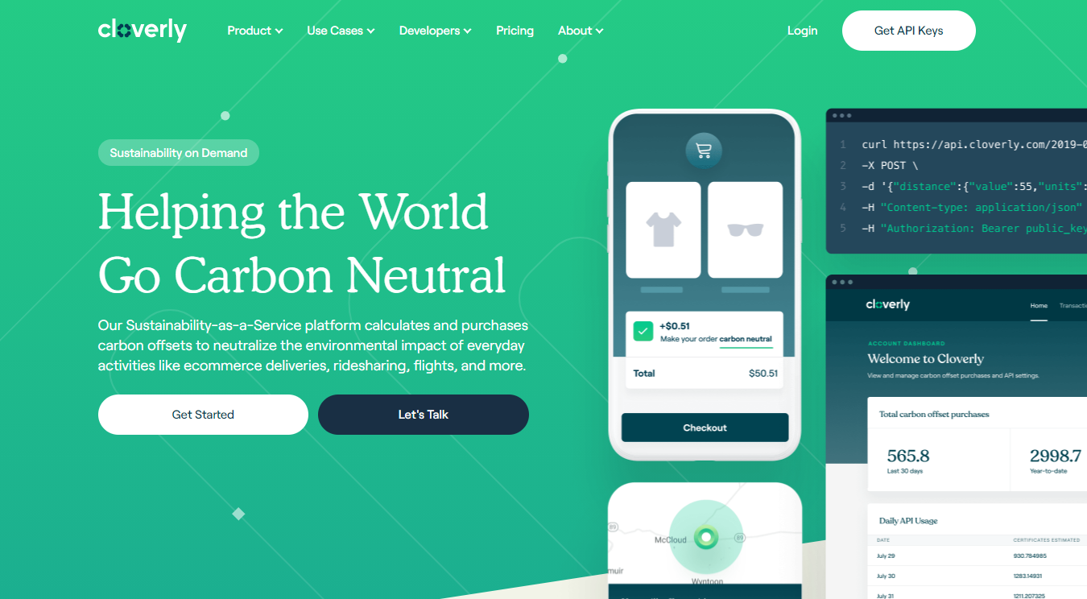
Unable to determine if they can truly calculate carbon.
They estimate by inputting weight (in kg) then it kicks out a price
No supply chain data
Looking to hire Software Engineers and Blockchain devs

Slide 20

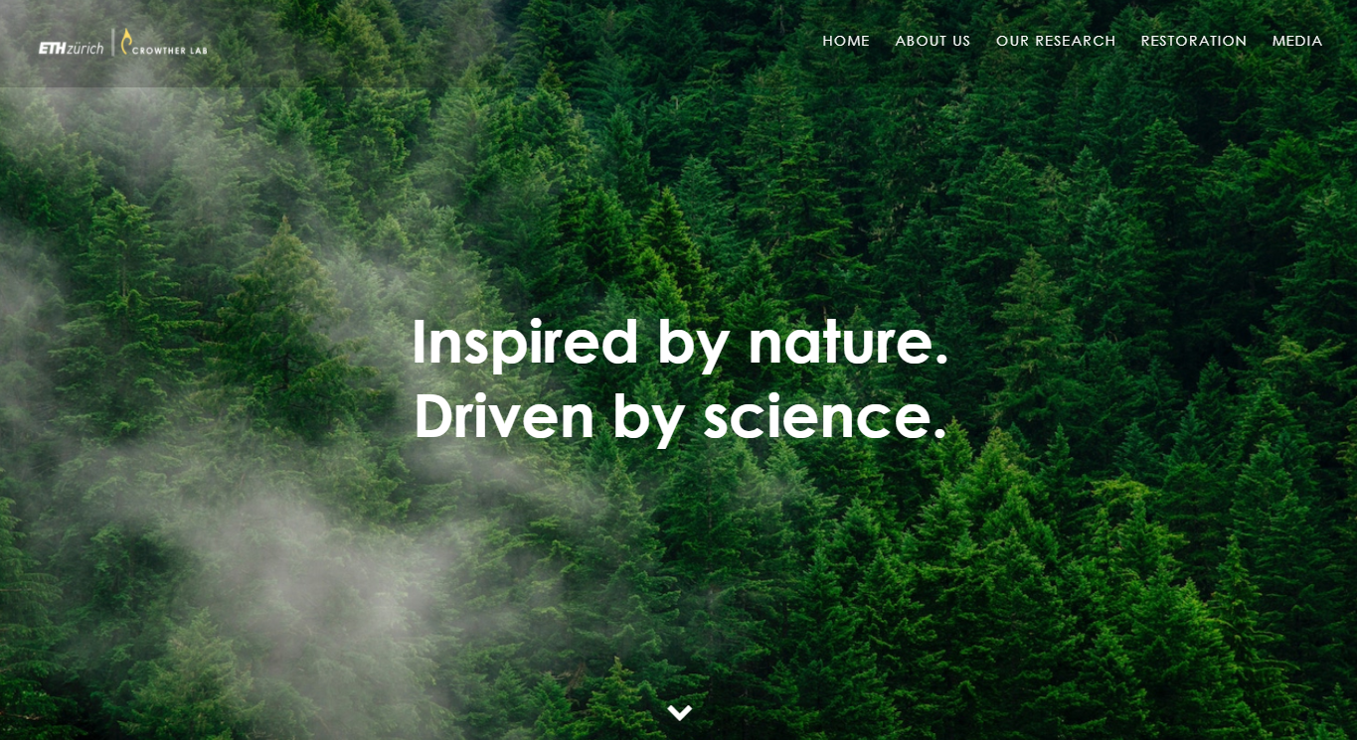
Excellent for PR and Marketing with name recognition and video content
Extensive research on the supply side
Could give Feedback on Cloverly API calculations
Tech wise nothing that could feed into our system

Slide 21

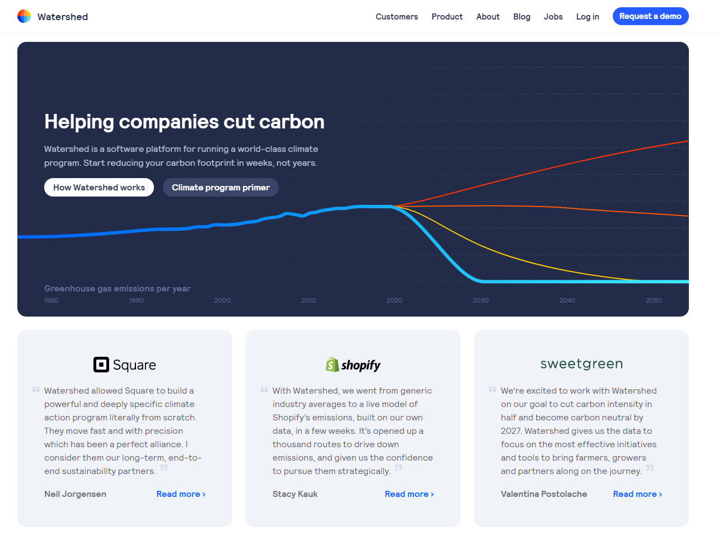
Can calculate a companies carbon footprint
Offer insights on how to reduce that footprint
Act as a middle man between business consumers and landowners for Carbon sales
Could be a good affiliate depending on their finder fees

Slide 22

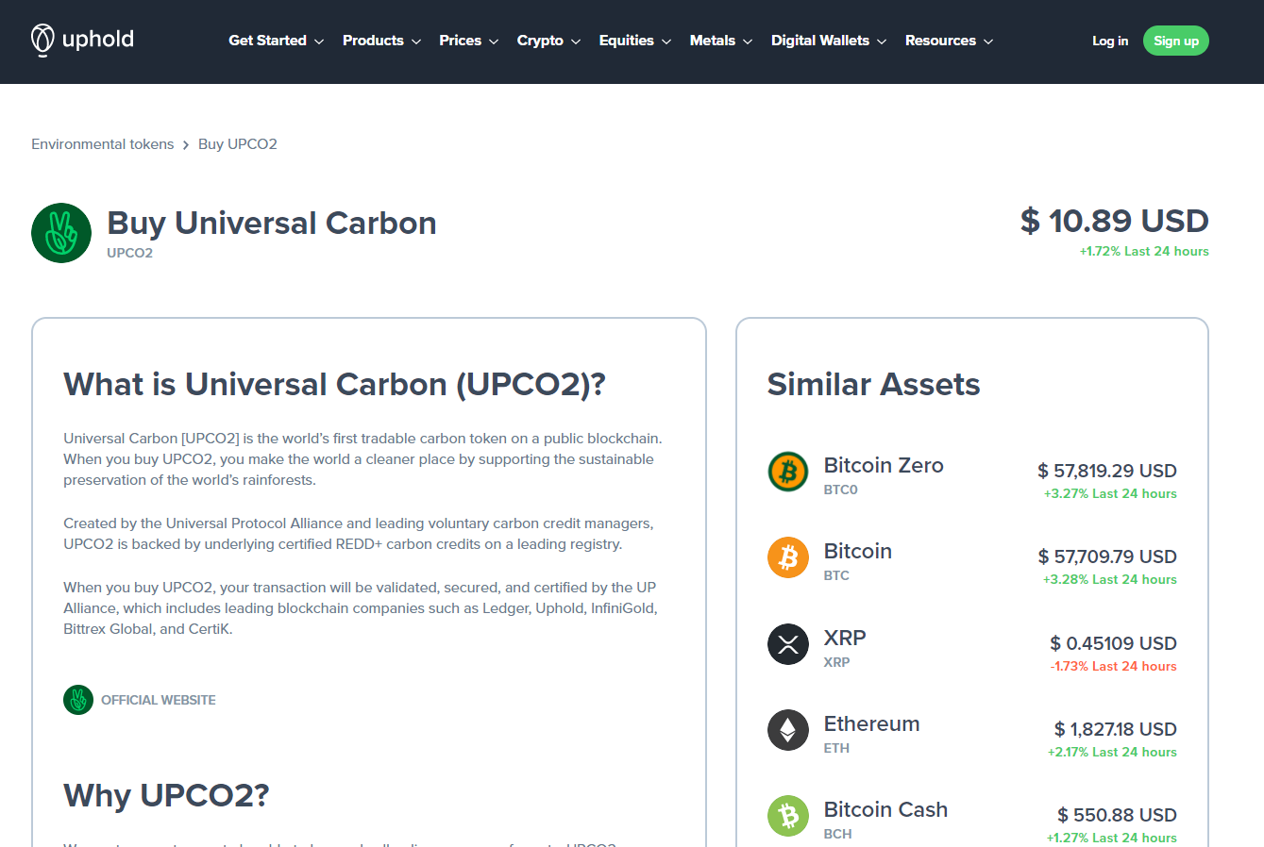
Exchange to buy and sell Crypto currency
First to market with a Carbon Credit crypto on the Ethereum network
“Each UPCO2 Token is backed on a 1:1 basis by a Voluntary Carbon Unit on a leading registry. Demand for carbon credits by companies and individuals seeking to offset their carbon footprints helps to drive the price of each UPCO2 Token”
Centralized token with no information about how they are acquiring the carbon credits

